Slide 1
Cloud Service Level Agreements

Slide 2

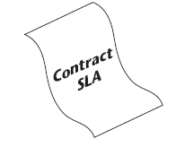
Definition
The SL A is a contract negotiated and agreed between a customer and a service provider

Slide 3

requirements
SLA format should clearly describe a service
Present the level of performance of service
Define ways by which the service parameters can
be monitored
Penalties when service requirements are not met

Slide 4
SLA Components
Purpose
Restrictions
Validity period
Scope
Parties
Service-level objectives (SLO)
Penalties

Slide 5
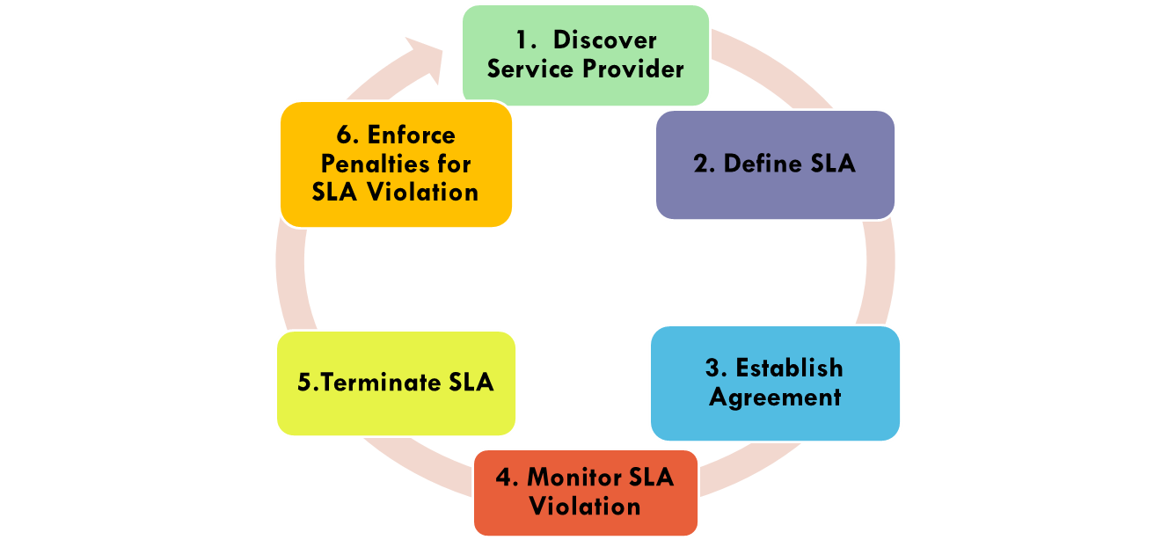
SLA Lifecycle

Slide 6
Discover service provider
In cloud computing environments it is important to locate resources that can satisfy consumers requirement efficiently and optimally
Resources are owned and operated by various providers

Slide 7
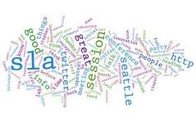
Define-SLA
it is necessary to identify the various elements of an SLA that will be signed by agreeing metrics
elements : QoS parameters, performanc , measurement, …

Slide 8
Establish Agreement
In this step an SLA template is constructed template has to include all aspects of SLA components

Slide 9
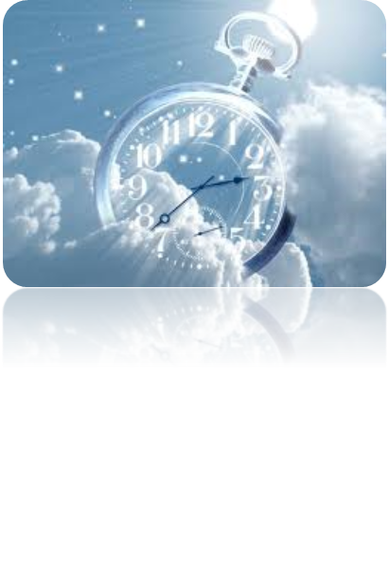

Monitor SLA violation
It plays a critical role in determining whether SLOs are achieved or violated
un-fulfillmen

Slide 10

Terminate SLA
a key aspect is to decide when it should be terminated
once decided, all associated configuration information is removed from the service systems
who is the party that triggered this activity
what are the consequences of it

Slide 11
Enforce penalties
A penalty clause can be applied to the party who violates SLA terms
a direct financial compensa-tion being negotiated and agreed between parties
SLA violation has two indirect side impacts on providers
Consumers use less service from the provider
provider’s reputation decreases

Slide 12
SLA Metrics for cloud services
SLA metrics for IaaS
SLA metrics for PaaS
SLA metrics for SasS
SLA metrics for Storage as a service

Slide 13
IaaS
Cloud IaaS SLAs are similar to SLAs for network services, hosting, and data center outsourcing. The main issues concern the mapping of high level application requirements on infrastructure services levels.
Metrics are well understood across the IaaS abstractions (compute, network, and storage). Consumers should expect to find the following metrics in their cloud SLA.
Compute metrics: availability, outage length, server reboot time Network metrics: availability, packet loss, bandwidth, latency, mean/max jitter

Slide 14
IaaS
Storage metrics: availability, input/output per second, max restore time, processing time, latency with internal compute resource
There are several standardization efforts within the IaaS space which help describe and manage the services offered at this level. Whenever possible, consumers should ensure the cloud SLA includes provisions requiring their cloud providers to support open standard interfaces, formats and protocols to increase interoperability and portability.

Slide 15
Summary: SLA metrics for IaaS
Parameter | Description
CPU capacity | CPU speed for VM
Memory size | Cash memory size for VM
Boot time | Time for VM to be ready for use
Storage | storage size of data
Scale up | Max of VMs for one user
Scale down | Min number of VMs for one user
Scale up time | Time to increase number of VMs
Scale down time | Time to decrease number of VMs
Availability | Uptime of service in specific time

Slide 16
PaaS
Two main approaches exist for building PaaS solutions: integrated solutions and deploy-based solutions. When reviewing the PaaS SLA, consumers should consider tradeoffs in flexibility, control, and ease of use to determine which approach best meets their business needs.
Integrated solutions, like Google App Engine (GAE), are web accessible development environments which enable developers to build an application using the infrastructure and middleware services supported by the cloud provider. Management of the application and its execution is primarily controlled by the cloud provider. Typically, service developers only have access to a provider-defined set of APIs

Slide 17
Deploy-based solutions enable deployment of middleware on top of resources acquired from an IaaS cloud provider, offering deployment services to the consumers which automate the process of installation and configuration of the middleware.6 These PaaS solutions offer a rich set of management capability including the ability to automatically change the number of machines assigned to an application, and self-scaling according to the application’s usage.
Consumers must distinguish between PaaS development environments and PaaS production environments when reviewing their cloud PaaS SLA.
consumers are advised to identify the PaaS services that are critical to their business and ensure that their cloud SLAs contain clear and measurable metrics for these services.

Slide 18
SLA metrics for PaaS
Parameter | Description
Scalability | Degree of use with large number of online users
Pay as you go billing | Charging based on resources or time of service
Servers
Browsers | Firefox , IE xplorer , ..

Slide 19
SaaS
Given the wide variation of services provided at the SaaS level, it is difficult to provide a comprehensive and representative list of SaaS service level objectives for consumers to look out for in their cloud SLAs.
Consumers should expect general SaaS service level objectives like monthly cumulative application downtime, application response time, persistence of consumer information, and automatic scalability to be included in their SLA.
Consumers should ensure that data maintained on the provider’s cloud resources be stored using standard formats to ensure data portability in the event that a move to a different provider is required.

Slide 20
SLA metrics for SasS
Parameter | Description
Scalability | Using with individual or large organisations
Availability | Uptime of software for users in specific time
Customizability | Flexible to use with different types of users

Slide 21
SLA metrics for Storage as a service
Parameter | Description
Geographic location | Availability zones in which data are stored
Scalability | Ability to increase or decrease storage space
Storage billing | How the cost of storage is calculated
Security | Cryptography for storage , authentication , authorization , …
Privacy | How the data will be stored and transferred
Backup | How and where images of data are stored
Recovery | Ability to recover data in disasters or failures
Transferring bandwidth | The capacity of communication channels

Slide 22


SLA negotiation
The first scenario involves direct negotiation between the cloud consumer and the cloud service provider
The second scenario is negotiation via trusted agent
In the third scenario more than one agent is used to carry out the one type of negotiation

Slide 23
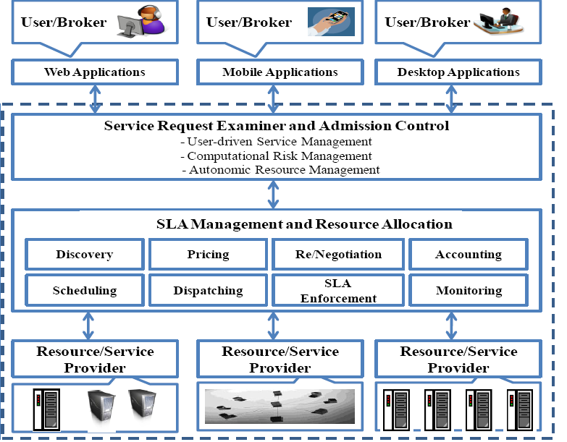
SLA-Oriented Architecture

Slide 24

SLA Management Frameworks and Languages
Bilateral Protocol
WS-Agreement
Web Service Level Agreement (WSLA)
WSOL
SLAng
QML
QuO

Slide 25
WSLA
WSLA is a framework developed by IBM to specify and monitor SLA for Web Services
WSLA consists of a set of concepts and a XML language
WSLA comprises of mainly three entities.
SLA parameters
parties
SLO

Slide 26
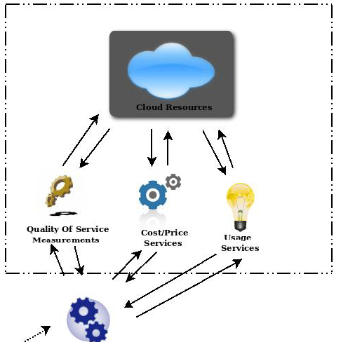
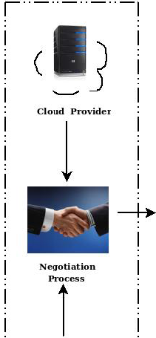
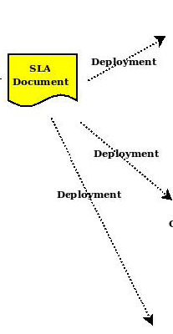
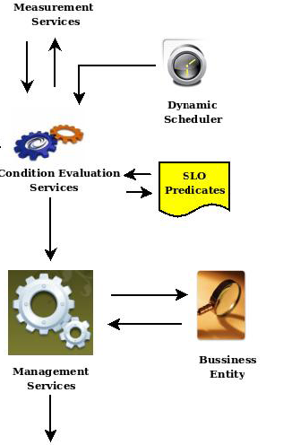
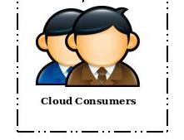
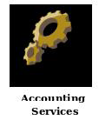
WSLA Architecture

Slide 27
Related work
SLA@SOI provides two major benefits to the provisioning of services
- service predictability
- automation

Slide 28
Conclusion
service level agreement is the key to ensure a service provider delivers the agreed terms of services
cloud consumers with SLA parameters and negotiation can increase trust level of relationship
We can manage SLAs with languages like WSLA, WS-Agreement

Slide 29
Refrences
[1] M.Alhamad, T.Dillon, E.Chang, (2010), Conceptual SLA Framework for Cloud Computing”, 4th IEEE International Conference on Digital Ecosystems and Technologies (IEEE DEST 2010) © 2010 IEEE
[2] P.Patel, A.Ranabahu, A.Sheth, “Service Level Agreement in Cloud Computing”, Knoesis Center, Wright State University, USA.

Slide 30
Refrences
[3] L.Wu, R.Buyya, “Service Level Agreement (SLA) in Utility Computing Systems”, The University of Melbourne, Australia.
[4] I.Brandic, V.Emeakaroha, M.Maurer, S.Dustdar, (2010) “LAYSI: A Layered Approach for SLA-Violation Propagation in Self-manageable Cloud Infrastructures”, 2010 34th Annual IEEE Computer Software and Applications Conference Workshops.
[5] J.Oriol Fit´o, ´I. Goiri, J.Guitart, “SLA-driven Elastic Cloud Hosting Provider”, Technical University of Catalonia Barcelona, Spain.

Slide 31
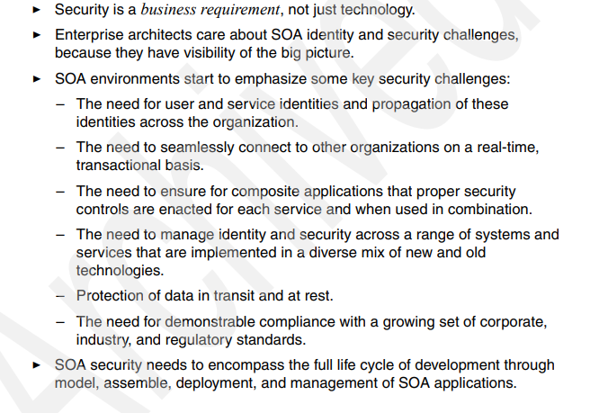

Slide 32
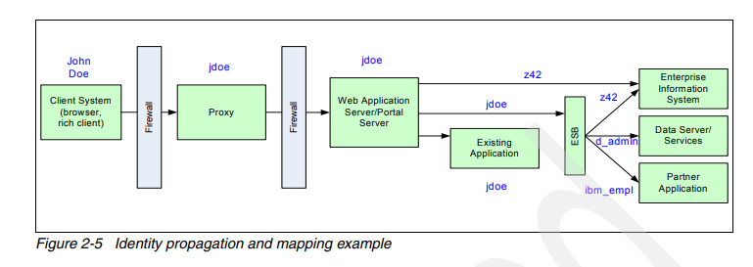

Slide 33
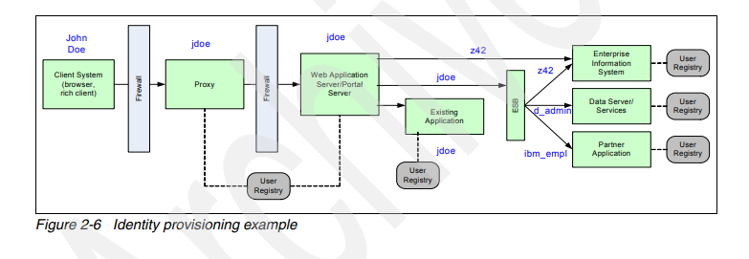

Slide 34
